Slide 1

Project 4 - Demystifying ML
Used cars price prediction
Jonathan Martinez

Slide 2
Objective
Develop a deep learning model for predicting the prices of used cars. By utilising advanced machine learning techniques, the model will analyse various factors such as car specifications, year model, mileage, brand, and other relevant features to accurately estimate the market value of a used car.

Slide 3
Process | Content
Data sourcing
Data collection (web scraping)
Data cleaning (drop columns and rows, null values, datatypes, etc.)
Data analysis and visualisation (plots and regression models)
Analysis of the results
Tableau (dashboard)
Conclusions

Slide 4



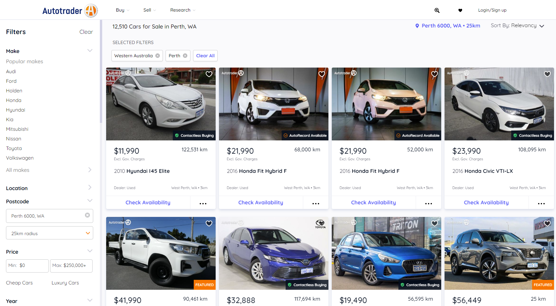

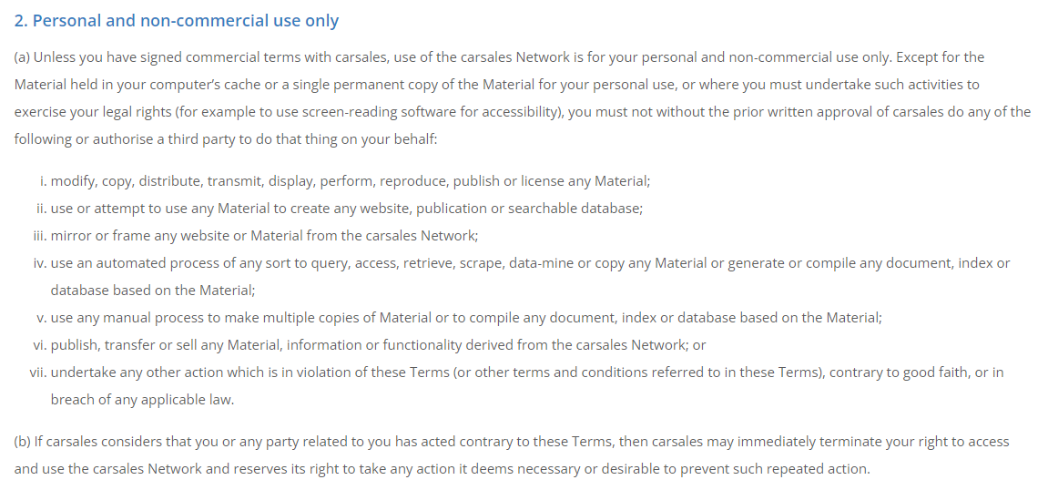
Data sourcing

Slide 5


Data collection
Site: https://www.autotrader.com.au/for-sale/wa/perth?distance=25
Scope: Perth WA, 25km radius from postcode 6000.
Pages scraped on the website: 251
Data size: 57 columns, 5671 records (many duplicates due to interruptions of a random survey prompt that stopped the scraping process). Records expected: 3,000.
Output: csv file (output_from_1_to_251.csv).

Slide 6
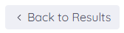
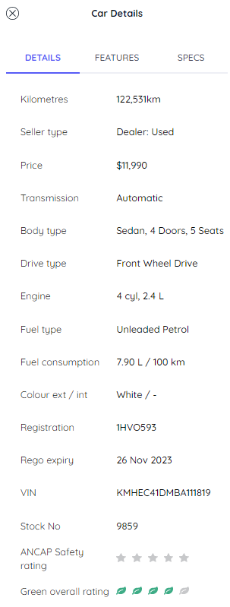
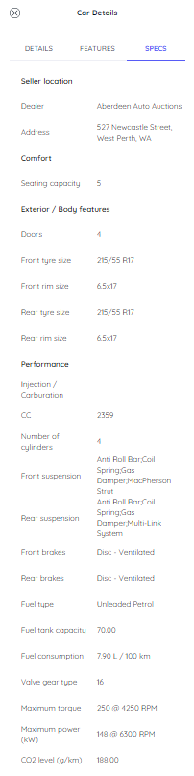

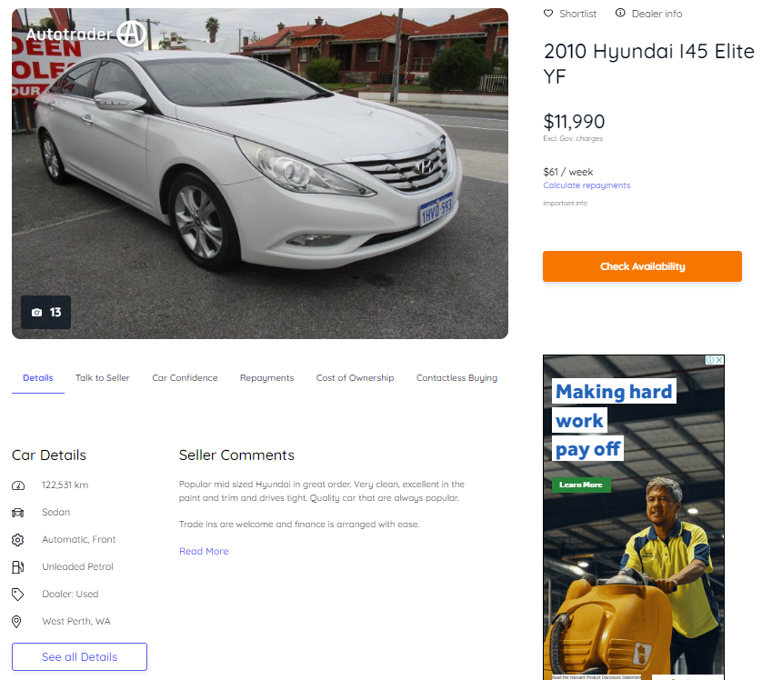

Data collection

Slide 7
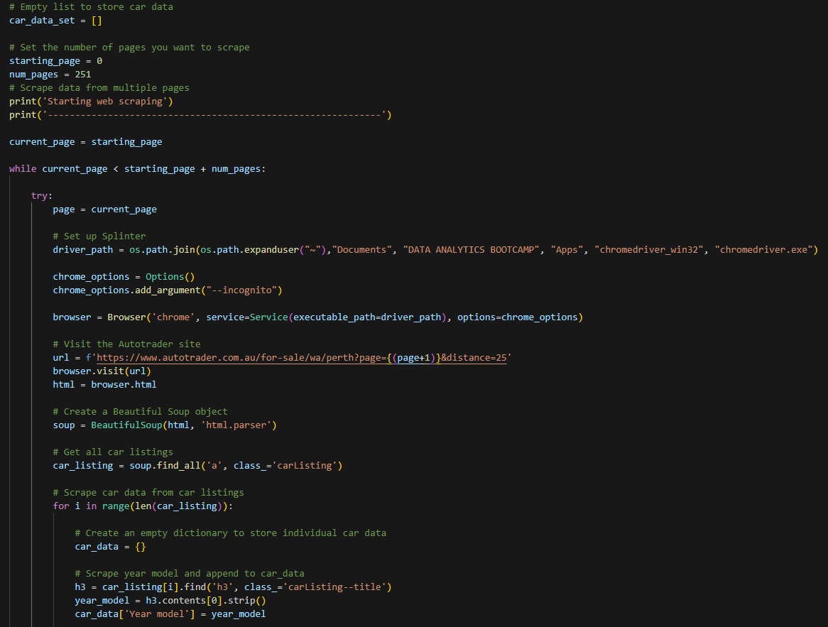
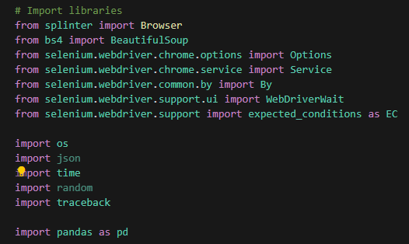
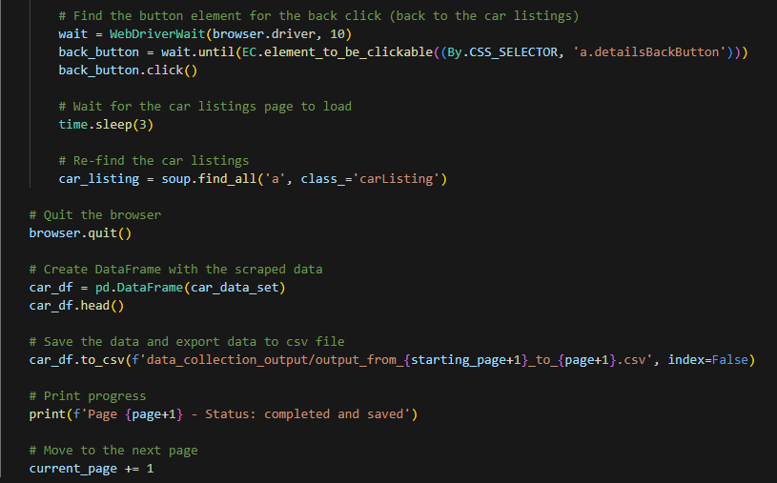
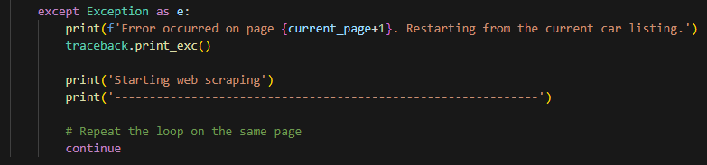
Data collection

Slide 8


Data cleaning
Method: Drop columns, drops rows, drop null values, remove duplicates, change datatypes, binning/grouping values, rename columns, regex, get latitude and longitude.
Tools used: Pandas / Pandas DataFrame, Geoapify (request).
Data size: 27 columns, 2126 records.
Data cleaned columns: 'Year model', 'Car Spec', 'Kilometres', 'Price', 'Transmission', 'Body type', 'Drive type', 'Fuel type', 'Fuel consumption per 100km', 'Colour ext', 'VIN', 'Dealer', 'Address', 'Seating capacity', 'Doors', 'CC', 'Number of cylinders', 'Fuel tank capacity', 'Valve gear type', 'Peak torque (Nm)', 'Horsepower', 'Kerb weight', 'Make', 'Model', 'Variant', 'Lat', 'Lon'.
Output 1: csv file test before the geoapify call is executed (used_cars_dataset_test.csv)
Output 2: csv file inclduing location after the geoapify call is executed (used_cars_dataset_loc.csv)
Output 3: csv file after validating lat a lon were received correctly and adjusted (used_cars_dataset_complete.csv)

Slide 9
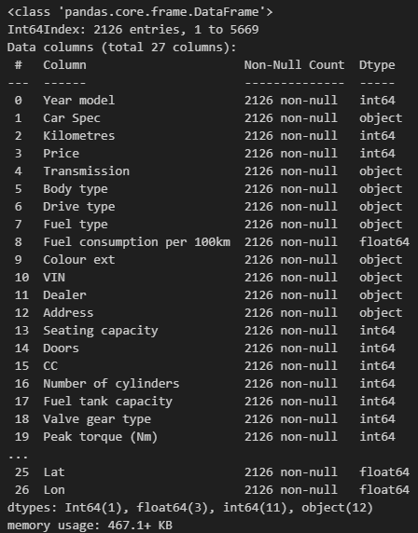
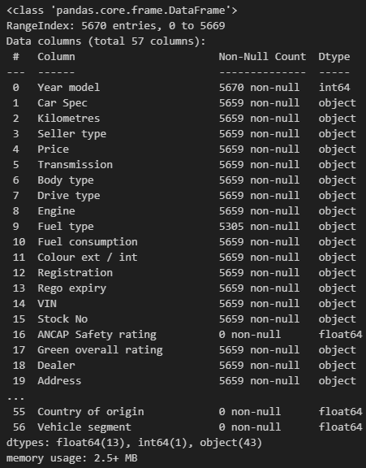
Data cleaning
Final data info
Initial data info
Data cleaning
Drop duplicates
Drop nulls
Drop unnecessary columns
Bin/Group data values
Rename columns
Regex and splits
Geoapify requests
Change data types

Slide 10
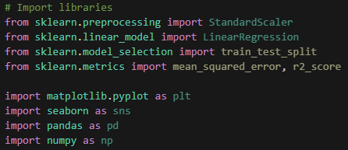

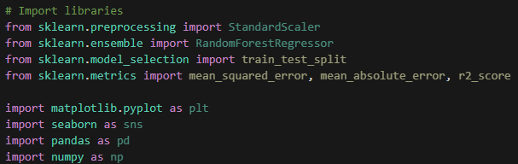

Data analysis
Method: Supervised learning (linear regression and random forest regression).
Tools used: Scikit-learn, Seaborn, Matplotlib, Pandas / Pandas DataFrame.
Process:
1. Read the data and execute a descriptive analysis of the numerical values.
2. Understand the distribution of the data and the relationships between different variables and the target variable 'Price'. Plots of numerical and categorical data.
3. Preprocess the data (StandardScaler and get_dummies())
4. Regression models by using LinearRegression and RandomForestRegressor.

Slide 11
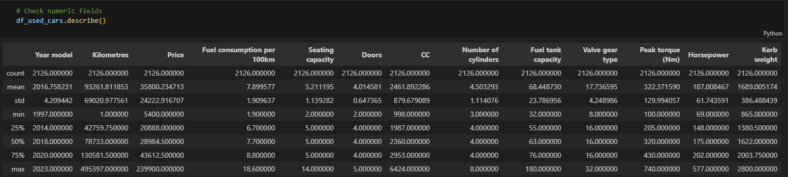
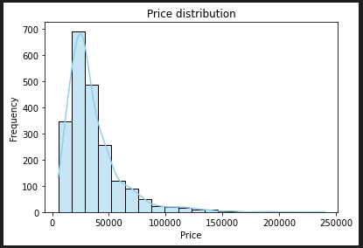
Data analysis and visualisations
Drop unnecessary columns
'Car Spec', 'VIN', 'Dealer', 'Address', 'Model', 'Variant', 'Lat', 'Lon'
Validate numeric fields
Identify the dependent variable y (target variable)
'Price'

Slide 12
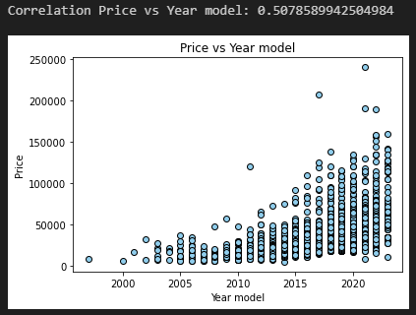
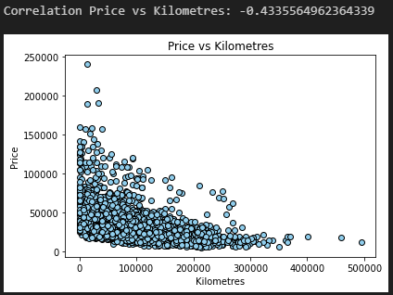
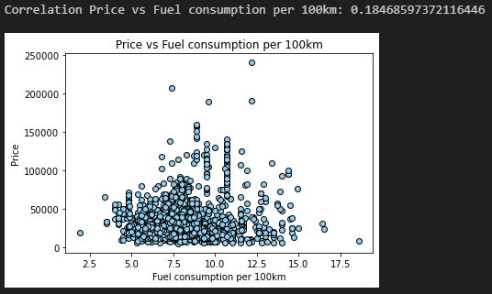
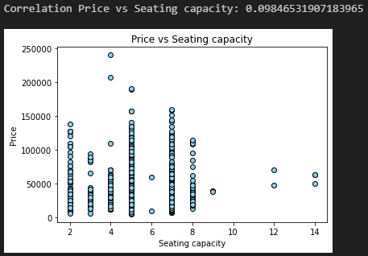
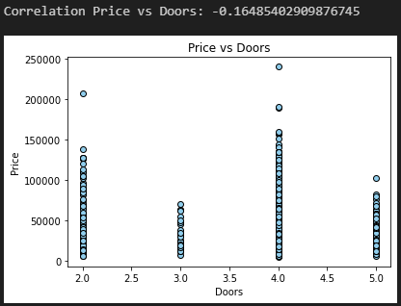
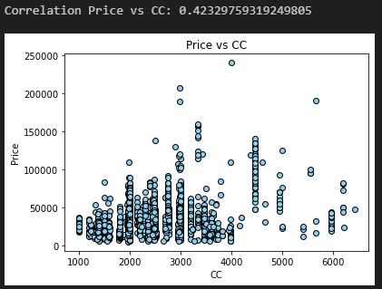
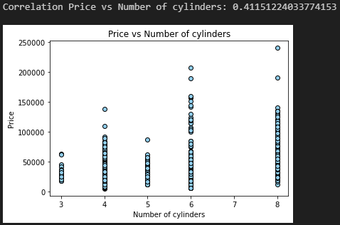
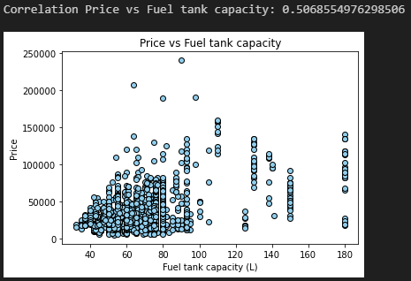
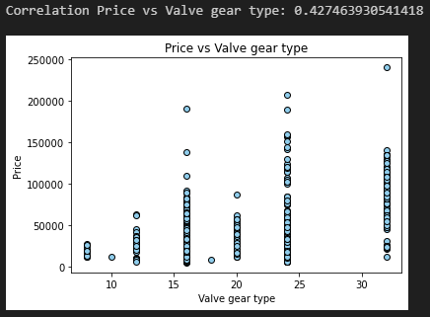
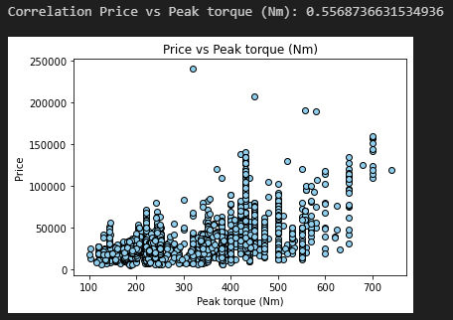
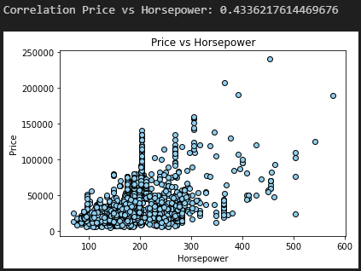
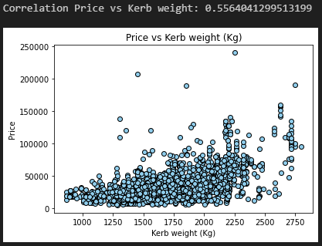
Data analysis and visualisations
Understand the distribution of the data and the relationships between different variables and the target variable 'Price'. Plots of numerical data.
Numerical data

Slide 13
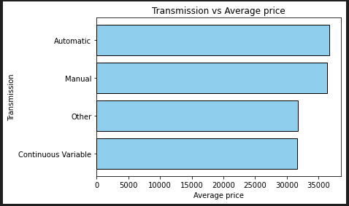
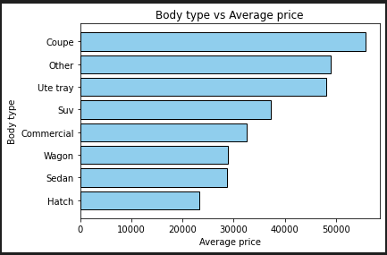
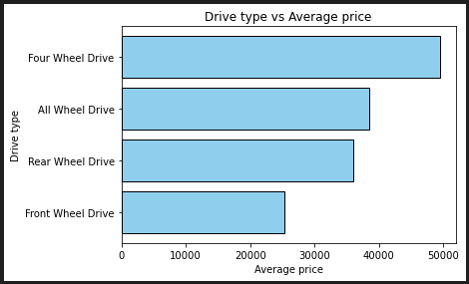
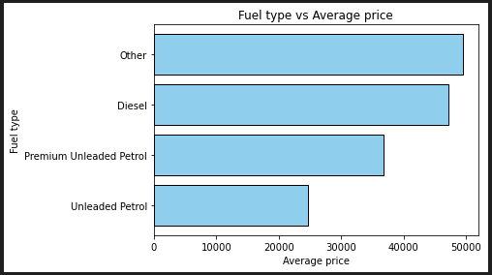
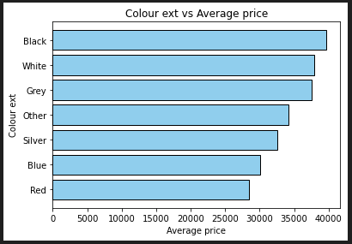
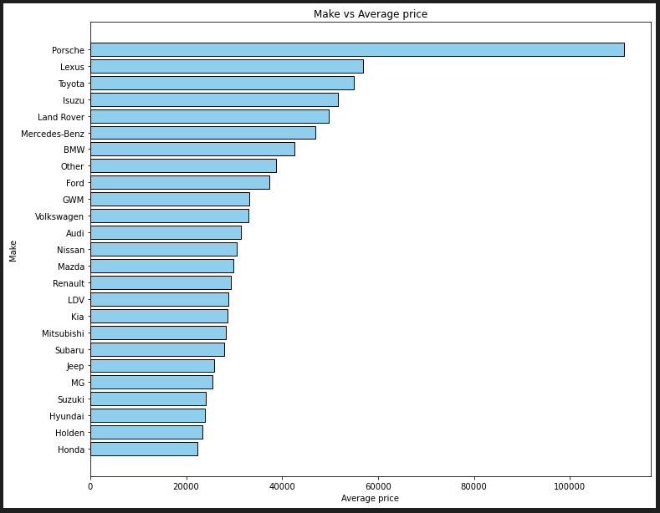
Data analysis and visualisations
Understand the distribution of the data and the relationships between different variables and the target variable 'Price'. Plots of categorical data.
Categorical data

Slide 14
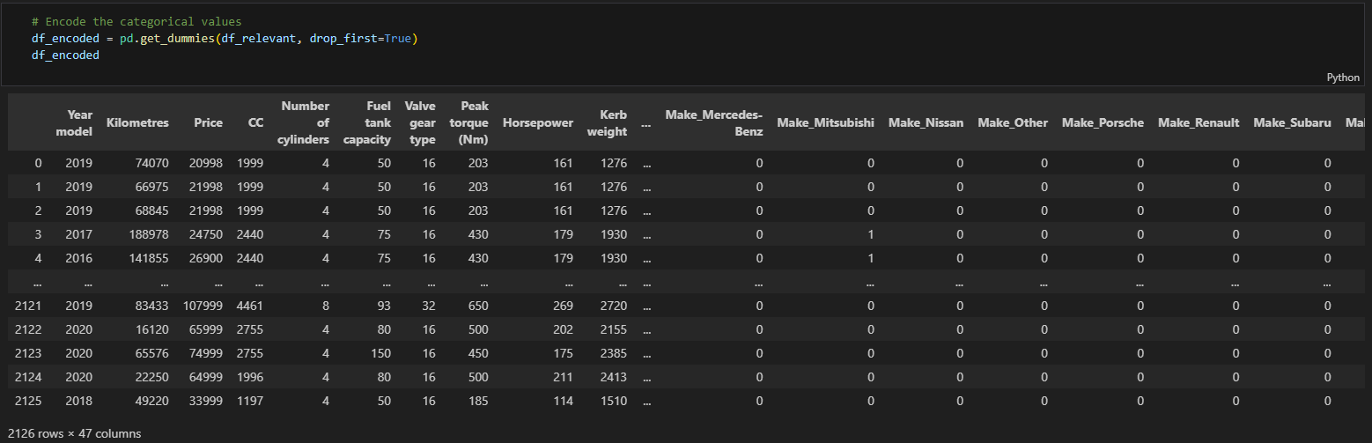
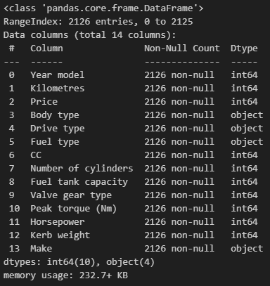
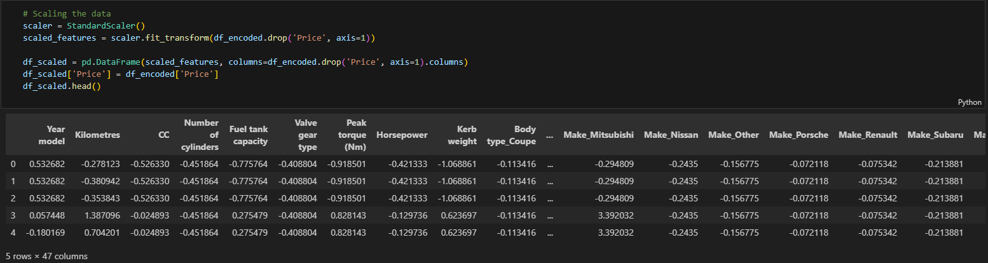
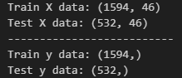
Analysis of the results
Encode categorical data
StandardScaler
‘X’ and ‘y’ test and train data (75%, 25%)
X (dependent variables)
y (independent variable)

Slide 15
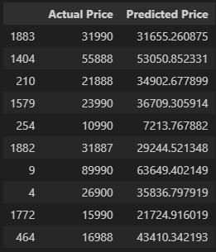
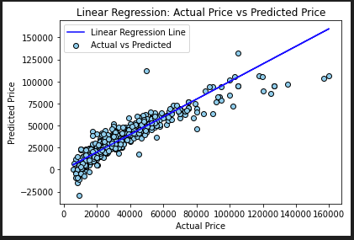
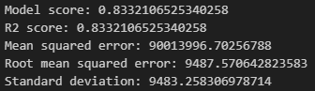
Analysis of the results
model = LinearRegression()

Slide 16
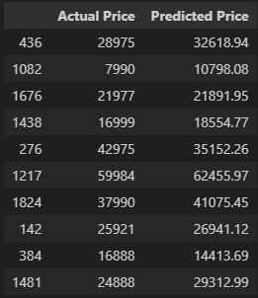
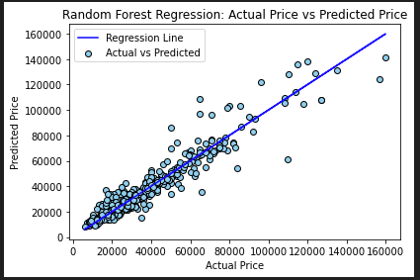
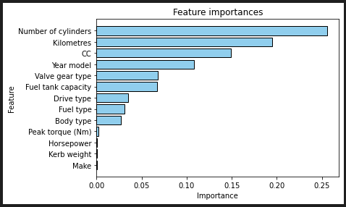
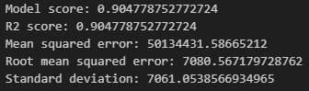
Analysis of the results
model = RandomForestRegressor(n_estimators=100)

Slide 17
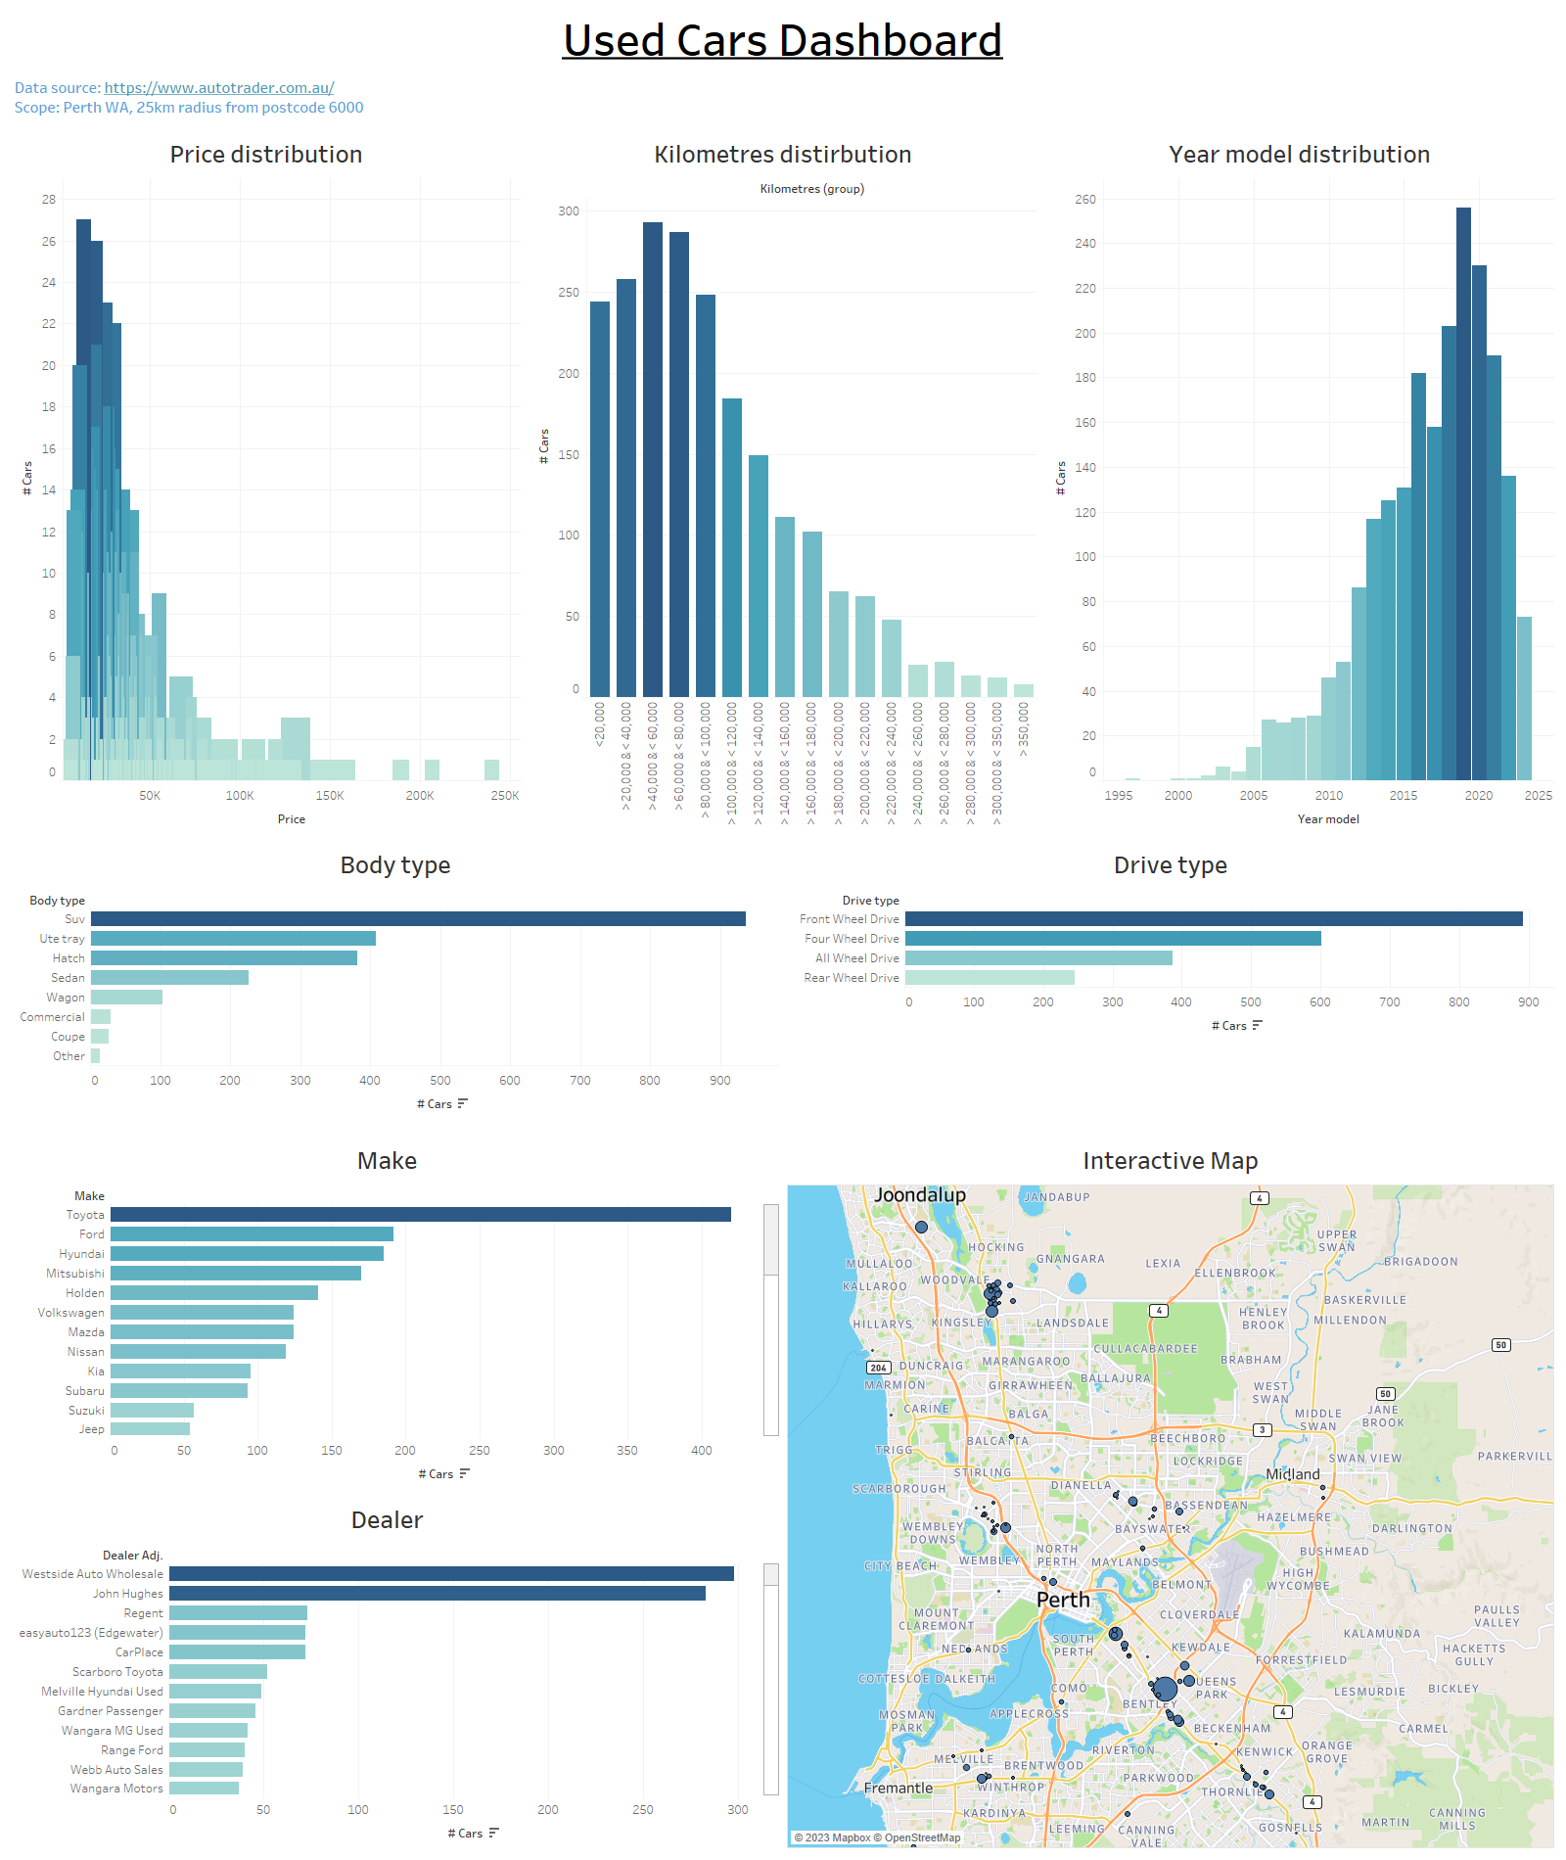
Tableau - Dashboard

Slide 18
Thank you
Jonathan Martinez

